Slide 1
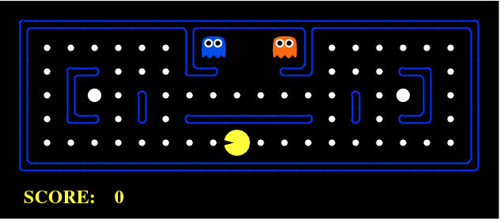
PROJECT REPORT
SEARCHING IN PACMAN

Slide 2
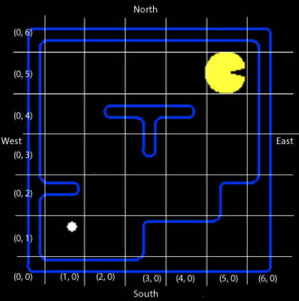
INTRODUCTION
The main objective of the project is to design algorithms to implement foundational searching algorithms concepts, like depth-first, breadth-first, uniform cost, and A* search in a game (here PACMAN).
GAME ENVIRONMENT
This is an environment that can easily map onto the general definitions of search problems and decision processes. These are what characterize most approaches to artificial intelligence.
Pac-Man consists of objects moving around on a set of squares that can be modeled as a grid. At any given time Pac-Man occupies a square and faces one of the four directions: north, south, east, or west. There may be walls in between the square or entire squares might be blocked by walls. Regardless, the location of Pac-Man is determined by the x and y coordinates of the grid as such:

Slide 3
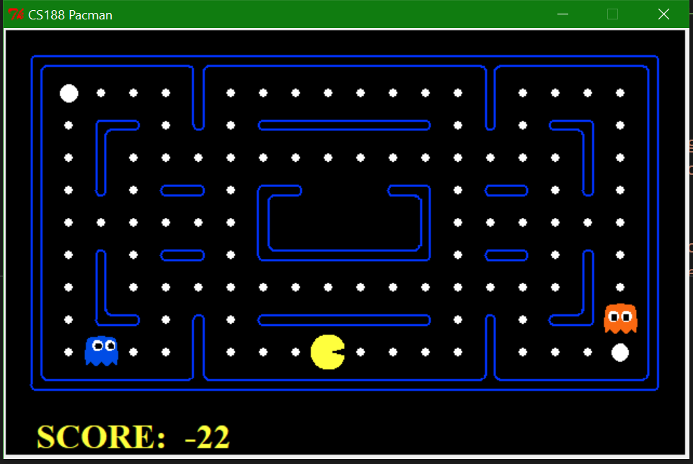
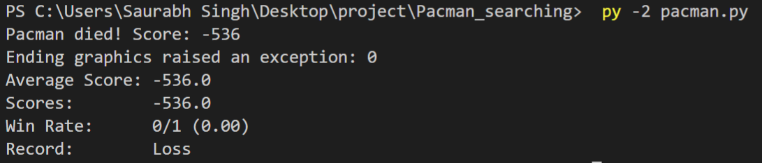
Command for basic Pac-Man game:
Pacumen provides a very basic Pac-Man game. In the game, you control the movements of Pac-Man using arrow keys on your keyboard. You can also use the traditional gamer WASD keys: w (up), s (down), a (left), d (right).
python pacman.py
The goal of the project is to write agent programs to control the actions of Pac-Man. That is, creating a Pac-Man agent. The project enables you to use different environments to try out your Pac-Man agent programs

Slide 4
ALGORITHMS IMPLEMENTED
DFS
BFS
UCS
Greedy Search
A* Search, etc.
PROCEDURE
Implemented generic search algorithms are called by pacman agents. These algorithms will go in the search.py file. In that file, there are methods put in place for you as placeholders:
depth_first_search()
breadth_first_search()
uniform_cost_search()
astar_search()
Aliases for these are dfs(), bfs(), ucs(), and astar().

Slide 5
These algorithms will be passed in as the search function to be used by the search agent. You can create your own search agents but the basis of one is already in place for you. This is called SearchAgent and is in the agents_search.py file. This is a very general search agent that finds a path through the maze. It does so using a supplied search algorithm for a supplied search problem and using a supplied heuristic.
By default, a SearchAgent tries to run a "depth first search" on a "position search problem" and uses a "null heuristic".
A heuristic function estimates the cost from the current state to the nearest goal in the provided SearchProblem. A null heuristic always returns a value of 0, which is a trivial heuristic stating that there is no cost.
SearchAgents are Agents
To see how this works, understand that a SearchAgent is a specific kind of generic Agent.
Any agent must define a get_action() method. This method receives a GameState and must return a direction constant, such as Direction.NORTH or Direction.WEST.
Further, an agent can define a register_initial_state() method and that will be called if it exists. This method is used to inspect the starting state.

Slide 6
Execution of Search Problems
You can run the generic search agent like this:
python pacman.py --layout tiny_maze --pacman SearchAgent
However, unless you have created a depth first search function, which is the default, you will see something like this:
[SearchAgent] using function depth_first_search
[SearchAgent] using problem type PositionSearchProblem
*** Method not implemented: depth_first_search
The above command is identical to doing this:
python pacman.py --layout tiny_maze --pacman SearchAgent -a fn=dfs
Here I’m just passing in the name of the search function, in this case "dfs". I could have also said "depth_first_search". Whatever you type here must be a function that you have provided.

Slide 7
DATA
Any search problem must provide the following elements:
METHODS | RETURN
get_start_state() | Returns the start state for the search problem.
is_goal_state() | Return True if and only if the state is a valid goal state.
get_cost_of_actions() | Returns the total cost of a sequence of actions. The sequence must be composed of legal moves.
get_successors() | Return a list of triples: successor, action, and step cost. Here 'successor' is a successor to the current state, 'action' is the action required to get to that successor state, and 'step cost' is the incremental cost of expanding to that successor.

Slide 8

Depth-First Search (DFS) Properties
Nodes expanded by DFS
Some left prefix of the tree.
Could process the whole tree!
If m is finite, takes time O(b^{m})
Space taken by fringe
Only has siblings on path to root, so O(bm)
Ending
m could be infinite, so only if we prevent cycles.
Optimality of Algorithm
Not optimal, it finds the “leftmost” solution, regardless of depth or cost.
1 node
b
…
b nodes
b² nodes
m tiers
b^{m} nodes

Slide 9
Breadth-First Search (BFS) Properties
Nodes expanded in BFS
Processes all nodes above shallowest solution
Let depth of shallowest solution be s
Search takes time O(b^{s})
Space occupied by the fringe
Has roughly the last tier, so O(b^{s})
Ending
s must be finite if a solution exists, so yes!
Optimality of algorithm
Only if costs are all 1 (more on costs later)
1 node
b
…
b nodes
s tiers
b² nodes
b^{s} nodes
b^{m} nodes

Slide 10
Uniform Cost Search (UCS) Properties
Selection of nodes:
Processes all nodes with cost less than cheapest solution!
The effective depth is roughly estimated as C*/ε where C* is the cost of the particular solution and ε is the minimum cost of the arc.
Time complexity is O(b^{C*/ε}) (exponential in effective depth.)
Space complexity:
The space complexity of the fringe is O(b^{C*/ε}), as it has roughly the last tier.
Ending:
Its completeness is based on two assumptions:
The best solution has a finite cost and
The minimum arc cost is positive.
Optimality:
It is an optimal algorithm (Proof next lecture via A*)
b
c ≤ 1
…
C*/ε “tiers”
c ≤ 2
c ≤ 3

Slide 11

Search Heuristics
A heuristic is:
A function that estimates how close a state is to a goal
Designed for a particular search problem
Examples: Manhattan distance, Euclidean distance for pathing
10
5
11.2

Slide 12


Admissible Heuristics
A heuristic h is admissible (optimistic) if:
where is the true cost to a nearest goal
Examples:
Coming up with admissible heuristics is most of what’s involved in using A* in practice.
15

Slide 13
Greedy Search
b
Strategy: expand a node that you think is closest to a goal state
Heuristic: estimate of distance to nearest goal for each state
A common case:
Best-first takes you straight to the (wrong) goal
Worst-case: like a badly-guided DFS
…
b
…

Slide 14
Combining UCS and Greedy
Uniform-cost orders by path cost, or backward cost g(n)
Greedy orders by goal proximity, or forward cost h(n)
A* Search orders by the sum: f(n) = g(n) + h(n)
8
g = 0 h=6
S
e
h=1
g = 1 h=5
a
1
1
3
2
g = 2 h=6
g = 9 h=1
S
a
d
G
b
d
g = 4 h=2
e
h=6
1
h=5
h=2
h=0
1
g = 3 h=7
g = 6 h=0
g = 10 h=2
c
b
c
G
d
h=7
h=6
g = 12 h=0
G
Example: Teg Grenager

Slide 15


Optimality of A* Tree Search
Assume:
A is an optimal goal node
B is a suboptimal goal node
h is admissible
Claim:
A will exit the fringe before B
…

Slide 16




Optimality of A* Tree Search: Blocking
Proof:
Imagine B is on the fringe
Some ancestor n of A is on the fringe, too (maybe A!)
Claim: n will be expanded before B
f(n) is less or equal to f(A)
…
Definition of f-cost
Admissibility of h
h = 0 at a goal

Slide 17


Optimality of A* Tree Search: Blocking
Proof:
Imagine B is on the fringe
Some ancestor n of A is on the fringe, too (maybe A!)
Claim: n will be expanded before B
f(n) is less or equal to f(A)
f(A) is less than f(B)
…
B is suboptimal
h = 0 at a goal

Slide 18

Optimality of A* Tree Search: Blocking
Proof:
Imagine B is on the fringe
Some ancestor n of A is on the fringe, too (maybe A!)
Claim: n will be expanded before B
f(n) is less or equal to f(A)
f(A) is less than f(B)
n expands before B
All ancestors of A expand before B
A expands before B
A* search is optimal
…

Slide 19
UCS vs A* Contours
Uniform-cost expands equally in all “directions”
A* expands mainly toward the goal, but does hedge its bets to ensure optimality
Start
Goal
Start
Goal

Slide 20
Video of Demo Contours
UCS
GREEDY
A*

Slide 21



Comparison
Greedy
Uniform Cost
A*

Slide 22
CONCLUSION
In this project we have implemented searching algorithms like depth first, breadth first, uniform cost search and a star search. These algorithms search for the presence of food pellets in the maze for the PACMAN agent. We compared the algorithms to find the most efficient searching algorithm to be implemented by the PACMAN agent so that the agent can have the maximum score.
REFERENCES
UC Berkeley CS188 Introduction to Artificial Intelligence Pac-Man project -http://ai.berkeley.edu/search.html
Wikipedia-https://en.wikipedia.org/wiki/Search_algorithm

